Slide 1
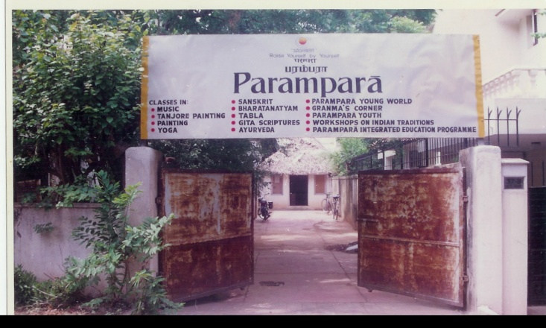
JOURNEY OF PARAMPARA
‘PARAMPARA’ A MOVEMENT IN SPREADING AWARENESS OF INDIAN TRADITION AND CULTURE STARTED ITS JOURNEY IN THE YEAR 1986

Slide 2
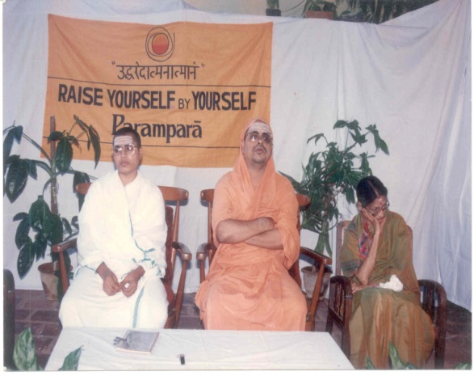
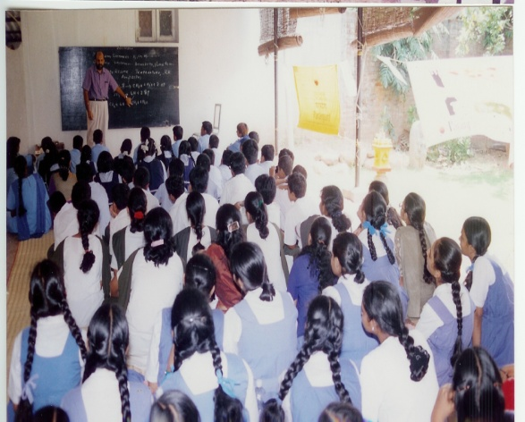
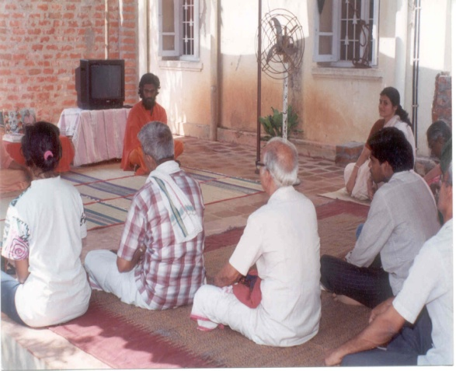
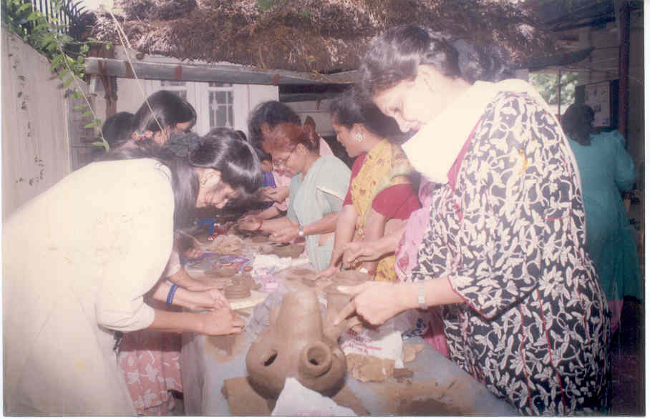
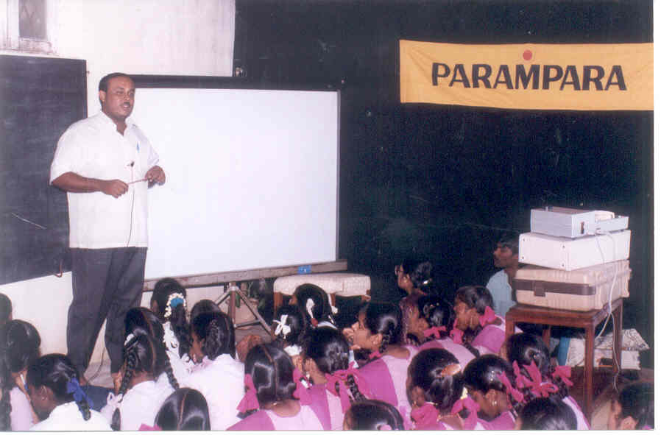
PARAMPARA WORKSHOPS PARAMPARA began systematically studying Indian Traditions, Culture and what made India so great, what were the reasons of its present day predicament – and how to be a participating factor in evolving life – raising the collective consciousness. Many projects were taken up from workshops – classes – on all levels – body, mind, spirit. There were Yoga – Music – Dance – chanting classes - Workshops of Jothish – Ayurvedha – Vastu sastra – Creative sculpture - Hindusthani Music - Introduction to Indian Heritage

Slide 3
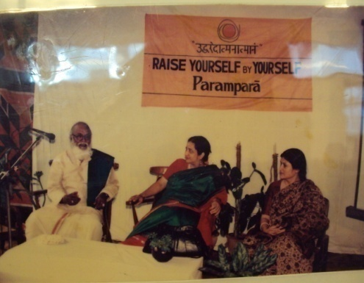
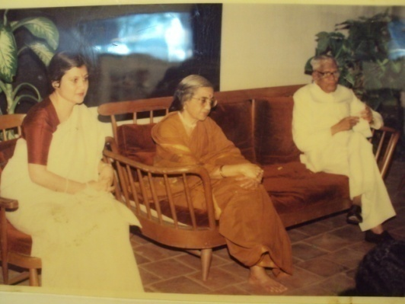
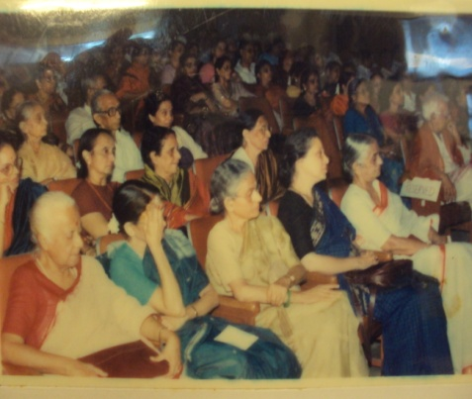
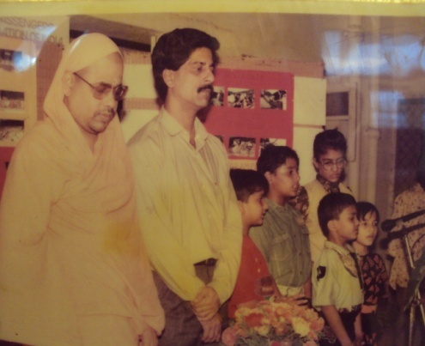
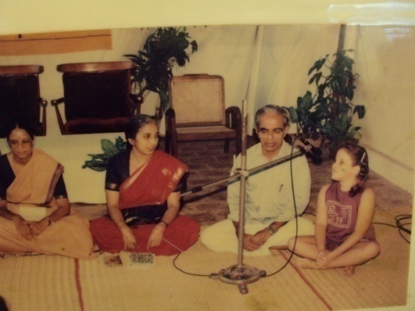
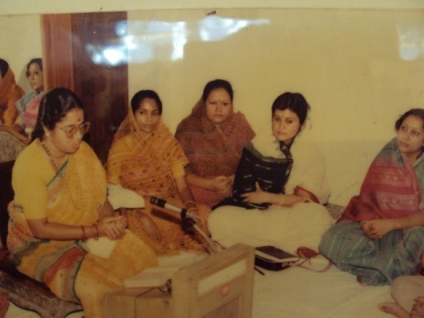
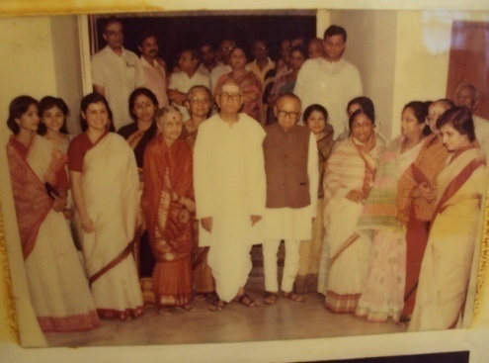
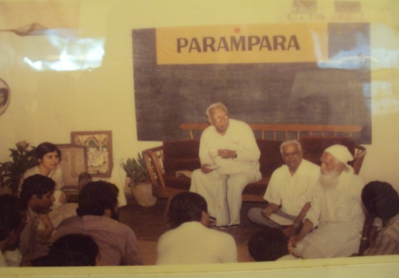
IMPORTANT DIGNITARIES VISIT TO PARAMPARA

Slide 4
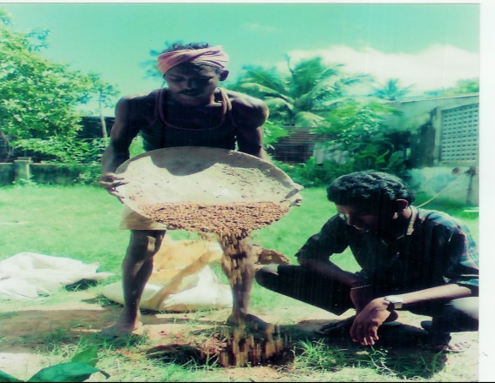
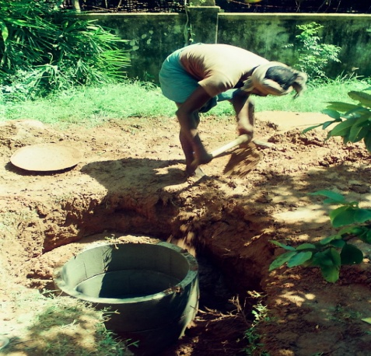
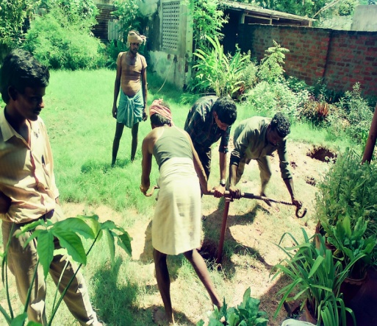
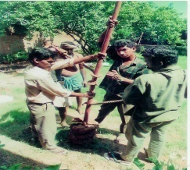
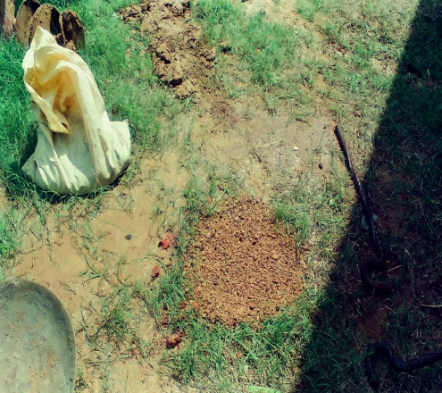
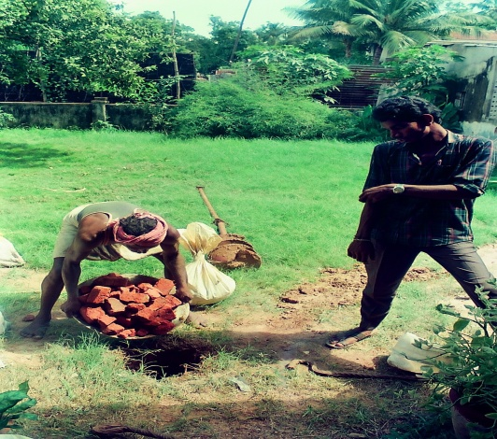
PARAMPARA WELFARE PROJECTS
WATER PERCOLATION PROJECT

Slide 5
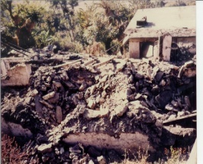
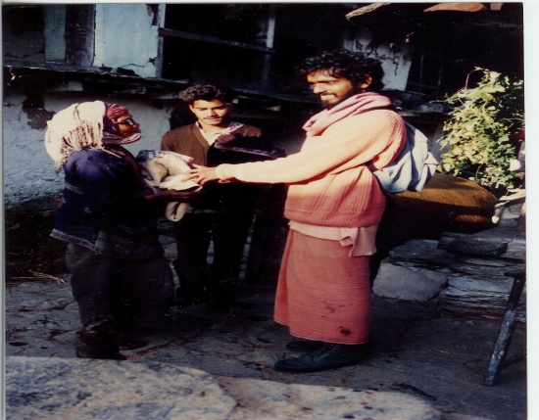
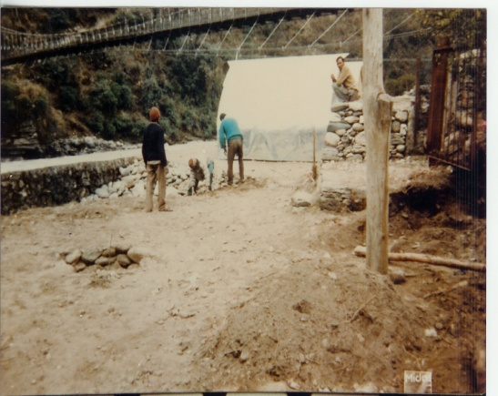
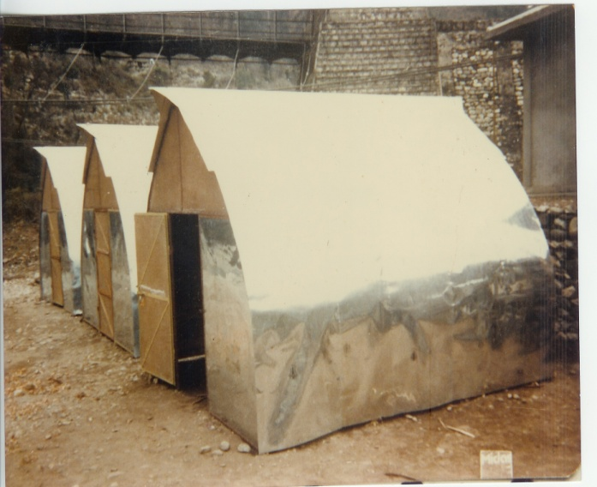
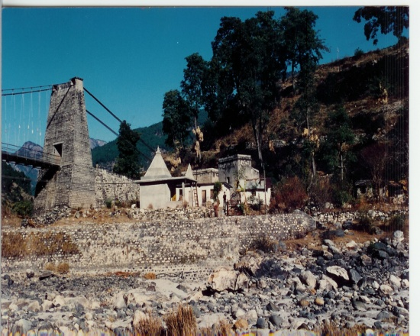
PARAMPARA REBUilt HOUSES for people hit by Earth Quake in utharkashi

Slide 6
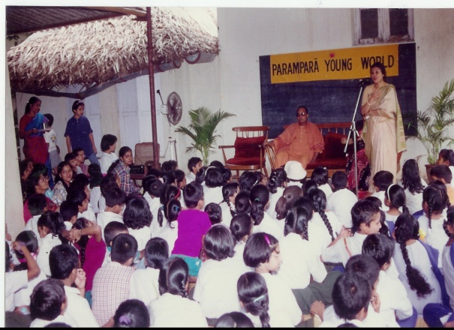
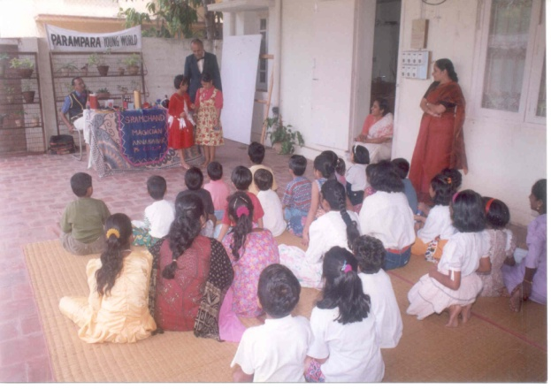
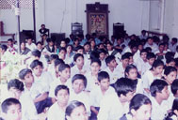
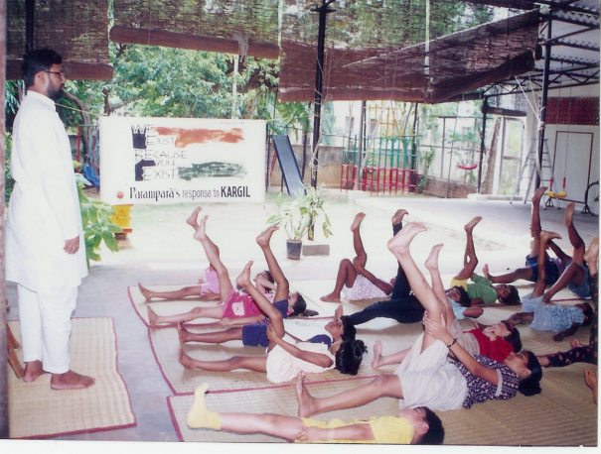
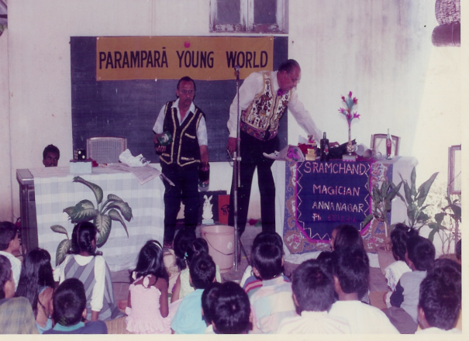
Young World PARAMPARA YOUNG WORLD ACTIVITIES FOR SCHOOL STUDENTS

Slide 7
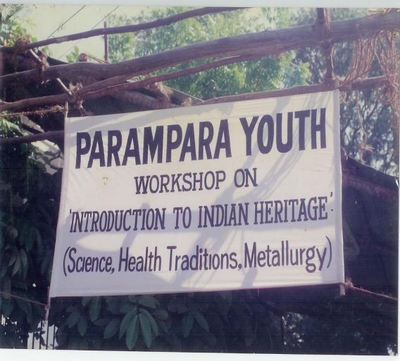
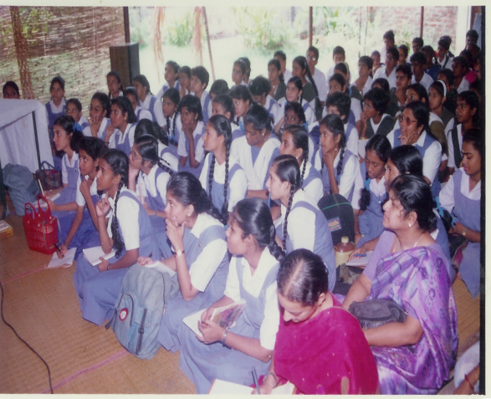
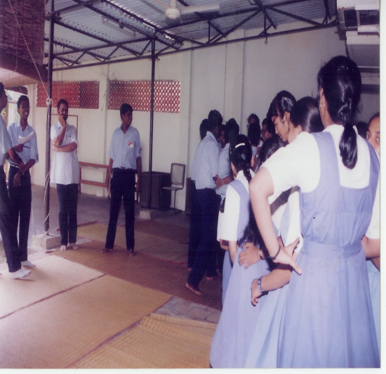
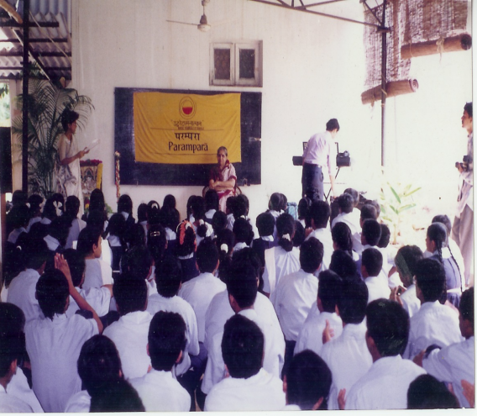
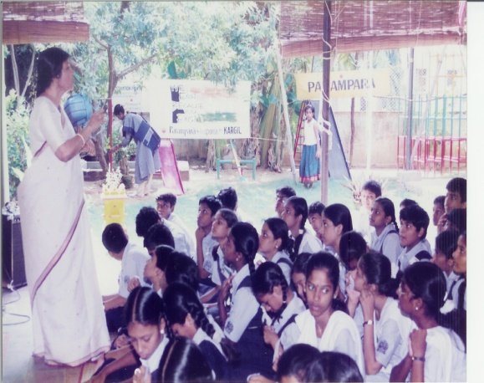
PARAMPARA YOUTH PROGRAMS

Slide 8
PARAMPARA AUSTERITY CENTRE
The Parampara Austerity Centre is a space for sharing and giving. It is a centre where people can donate their unused possessions. It is also the place where people with wants but not the means, can buy these articles at a nominal price. The proceeds from such sales will be used for our Integrated Education Programmes and Annadanam Schemes.

Slide 9
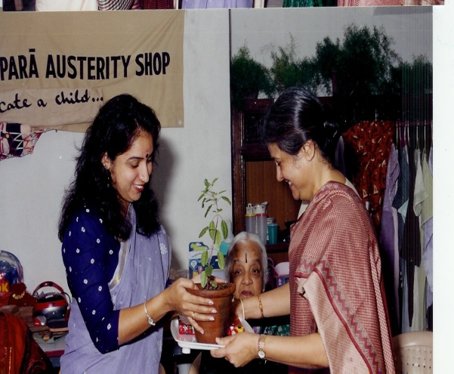
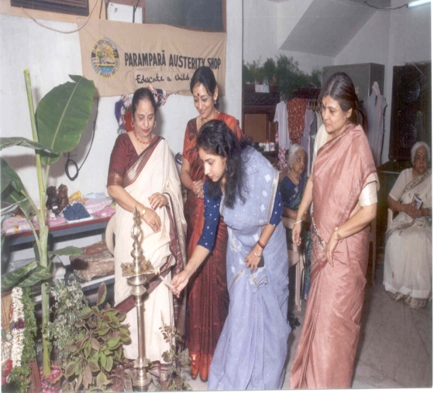
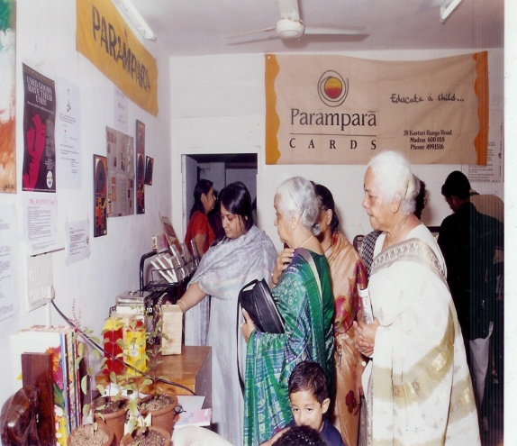
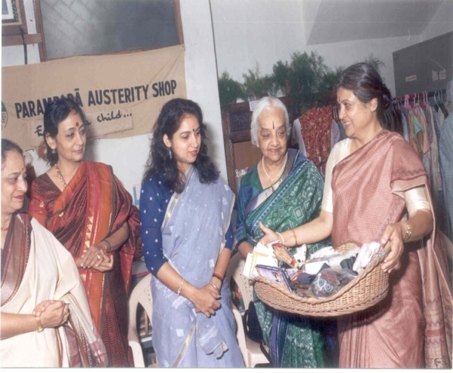
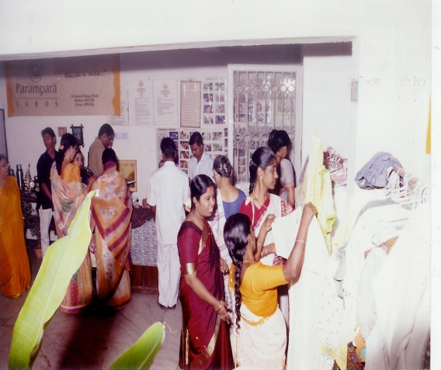
PARAMPARA AUSTERITY CENTRE
THE AUSTERITY SHOP AT R.K.SALAI WAS INAUGURATED IN THE YEAR 2003

Slide 10
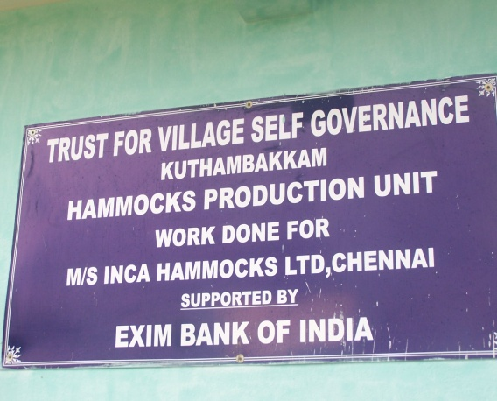
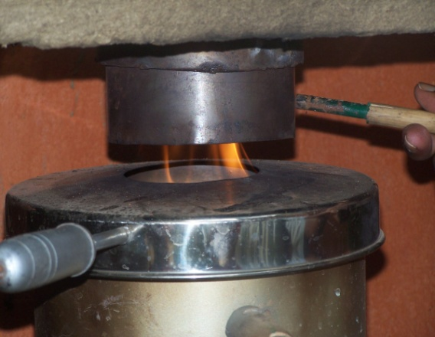
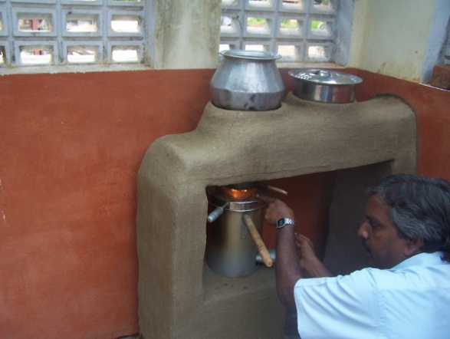
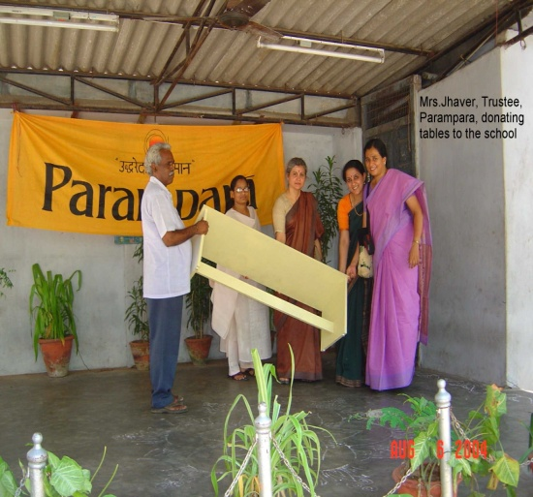
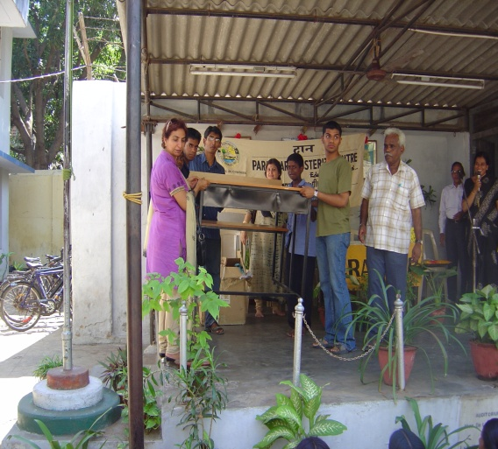
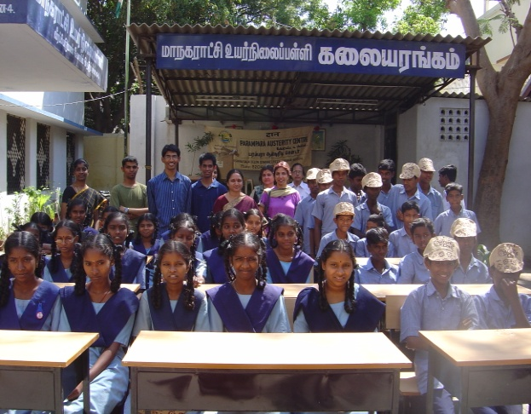
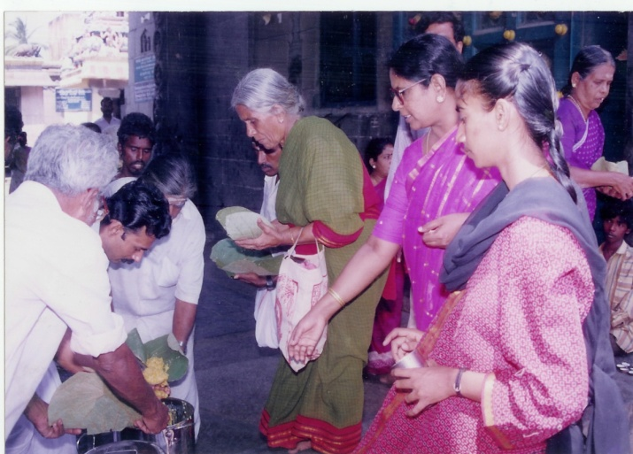
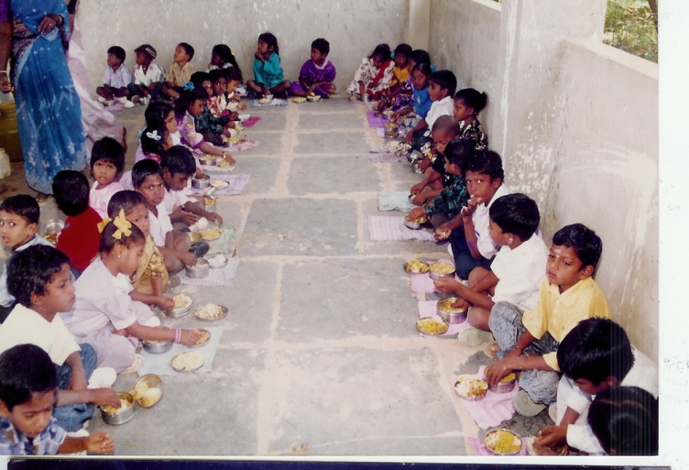
AUSTERITY DONATION GIVEN FOR DEVELOPMENT TO KUTHAMBAKKAM VILLAGE AND SCHOOLS AND ANNADHAN

Slide 11
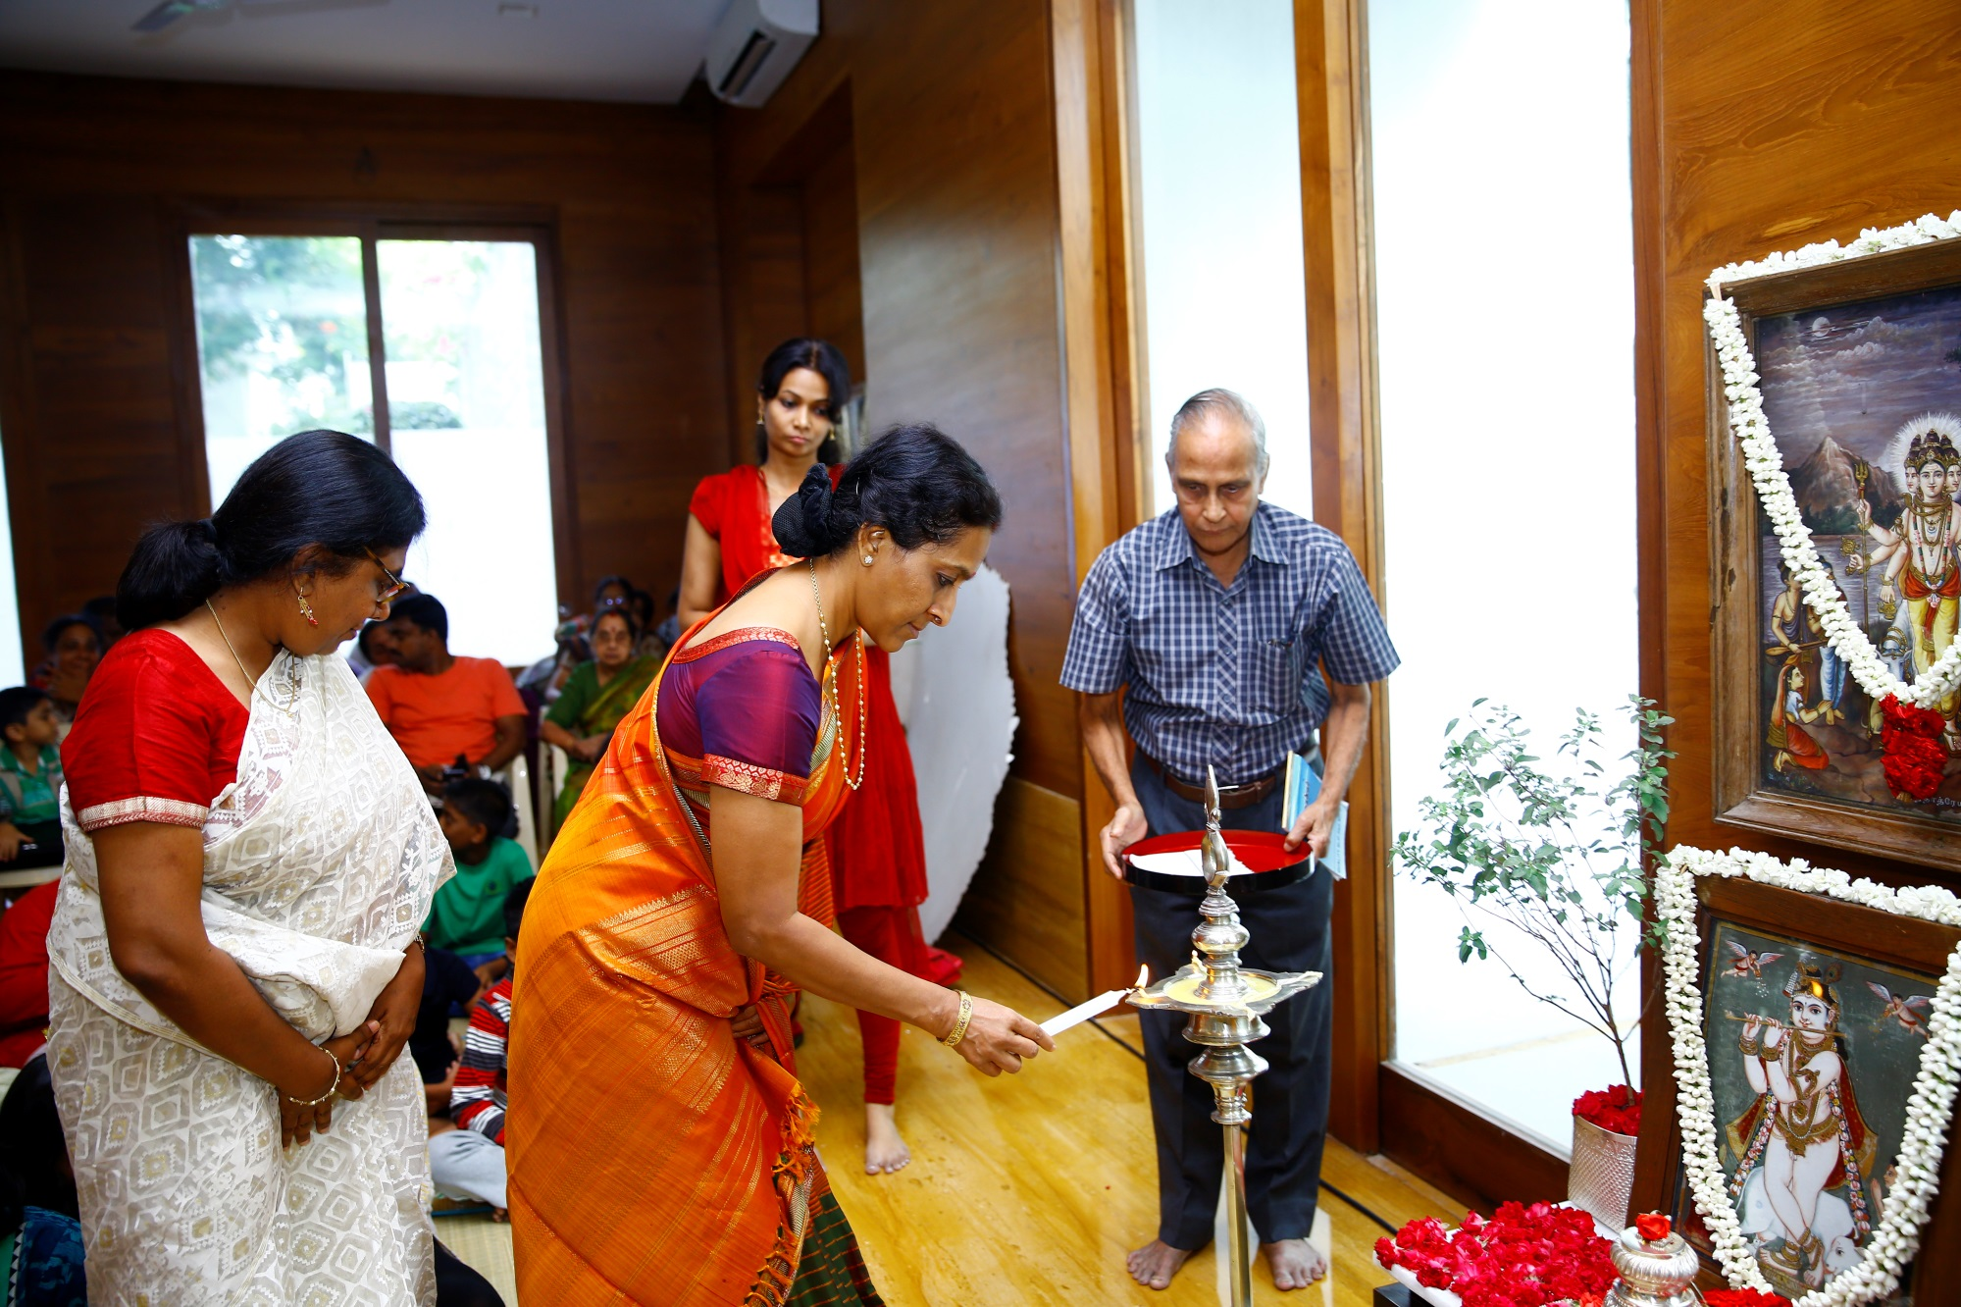
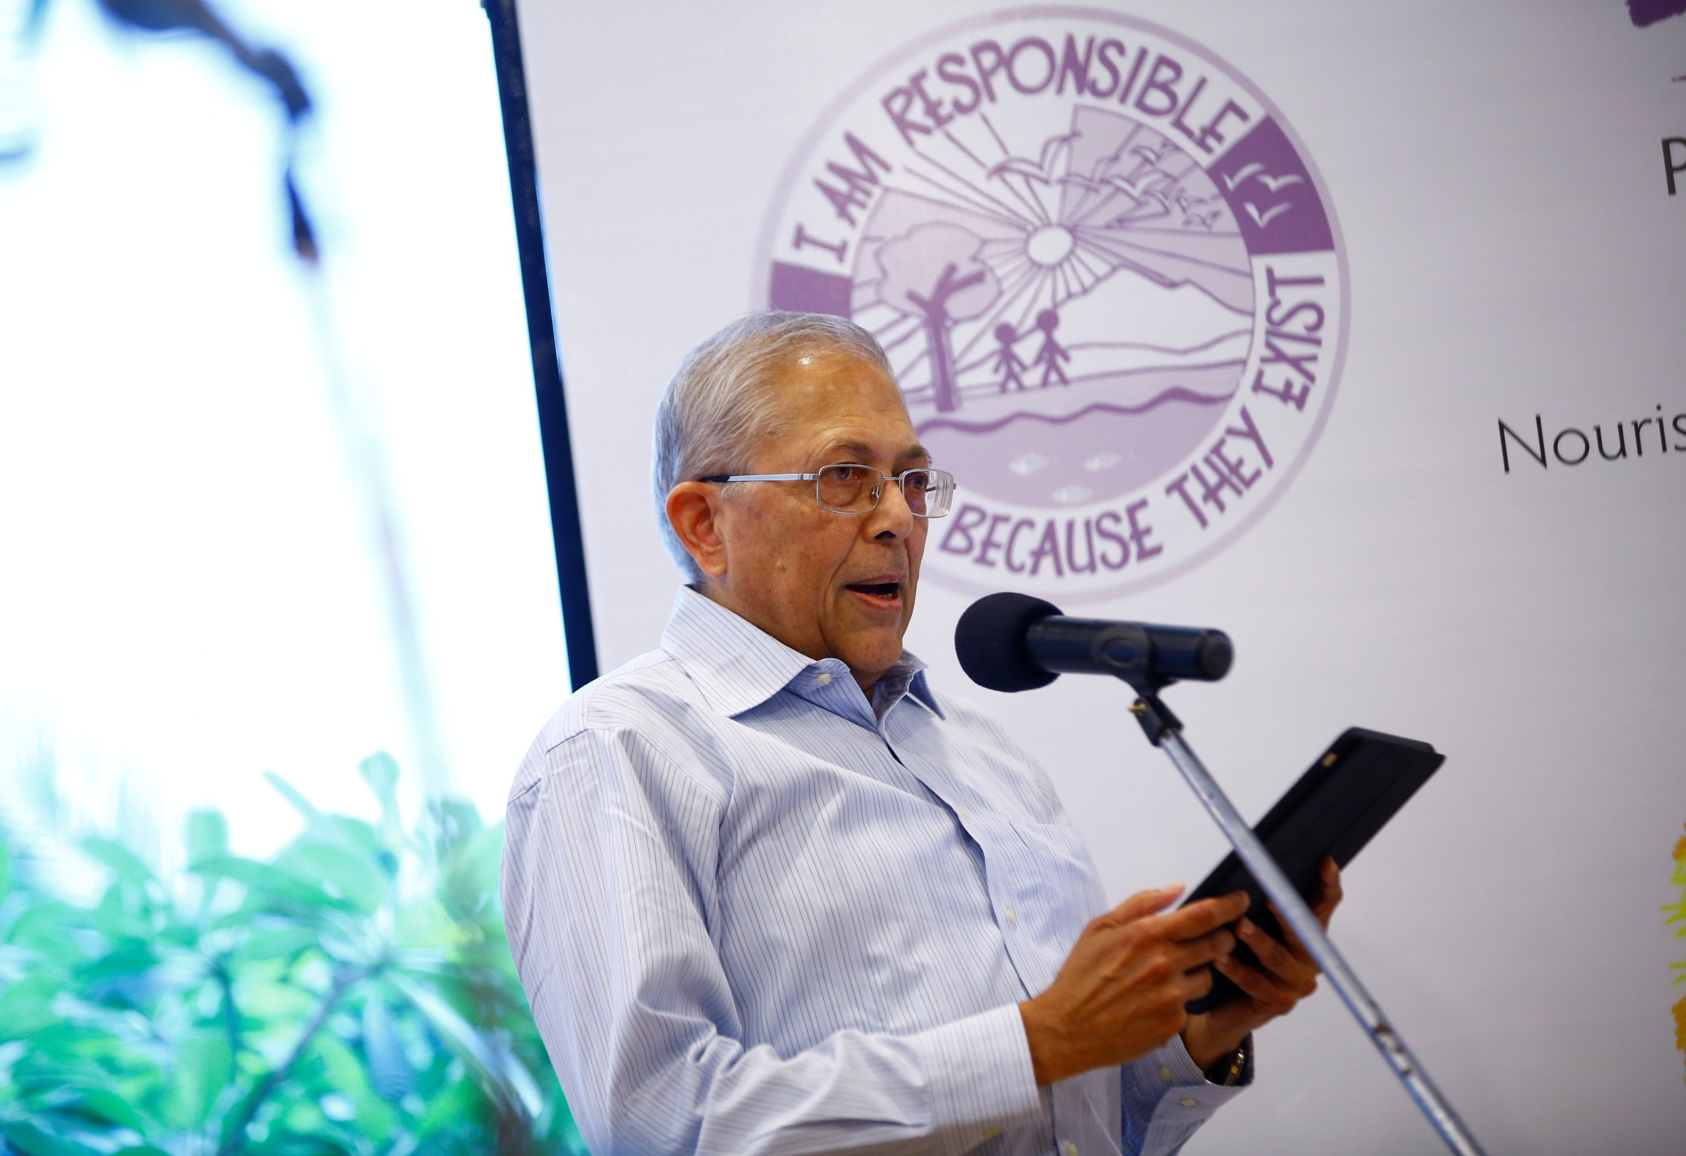
PARAMPARA AUSTERITY CENTRE INAUGURATION AT ALWARPET IN JULY 2014

Slide 12
AUSTERITY CENTRE INAUGURATION EVENTS – JULY 2014
Veda chanting by Ved pathshala students and few performances by school children.

Slide 13
WOMEN ORIENTED PROGRAMME OF PARAMPARA
Various workshops conducted by PARAMPARA included Gita
chanting, Breathing & Pranayam, Hindusthani Bhajans, Durga Saptasati etc...

Slide 14
PARAMPARA Rural camps AND DEVELOPMENT PROGRAMME AT RAJASTHAN
Drought relief / Cattle food Supplies / Water supply / Tank Cleaning

Slide 15
VAK PARAMPARA PARAMPARA PUBLICATIONS

Slide 16
PARAMPARA PANCHAVATI PROGRAMME

Slide 17
TULSI AWARENESS MOVEMENT
It is our goal in PARAMPARA to bring the story and glory of Tulsi to every home and that each child grows up nurturing Tulsi.

Slide 18
PARAMPARA TULSI VRINDHAVAN

Slide 19
TULSI VIVAH - 2009

Slide 20
TULSI VIVAH 2009

Slide 21
TULSI VRINDHAVAN AT SCHOOLS

Slide 22
TULSI VRINDHAVAN AT CANCER INSTITUTE

Slide 23
DISTRIBUTION OF TULSI SAPLINGS

Slide 24
LAUNCH OF EKADASI MOVEMENT JUNE - 2010

Slide 25
BHARATIYA VEDIC KRISHI PARAMPARA At Kairambedu, Guduvancheri
Obesiance to the Nature
All life is Agriculture , As we sow,so we reap
BHARATIYA VEDIC KRISHI PARAMPARA endeavour…..

Slide 26
BHARATIYA VEDIC KRISHI PARAMAPARA
Workshop on Natural Farming by School Students

Slide 27
BHARATIYA VEDIC KRISHI PARAMAPARA
At Kairambedu, Guduvancheri
Workshop on Natural Farming by School Students

Slide 28
PARAMPARA GOPASHTAMI UTSAV OCT - 2014

Slide 29
EKADASI UTSAV 2010

